Slide 1
Smartbuilding by using IBM Watson
By:Fantastic 3
Sachin
Swamydas
Mehul

Slide 2
Abstarct:
Smart building using IBM Watson. In this project we will work on the smart entry & exit system, fire & Smoke detector and smart lights. Smart lights is nothing but when it darkness then automatically lights will glow if it was day time then lights will automatically off.

Slide 3
Introduction :
Advances in building technologies are combining energy
efficiency, networked sensors, and data recording in exciting
ways. Modern facilities can adjust lighting, heating, and cooling
outputs to maximize efficiency, provide better physical security,
improve wayfinding for occupants, and provide detailed reports
of building use.

Slide 4
Hardware components :
Arduino UNO
Node MCU
LDR
Fire sensor
Smoke detector
Ultrasonic sensor
Servo motor

Slide 5
Software components:
MIT APP
Arduino IDE
IBM Watson Cloud Platform

Slide 6
BLOCK DIAGRAM:
LED
LDR
Buzzer
Smoke Sensor
Arduino UNO
Microcontroller
Servo Motor
Ultra Sonic
Node MCU
Fire Sensor
IBM Cloud Services
MobileAPP
Web Services

Slide 7
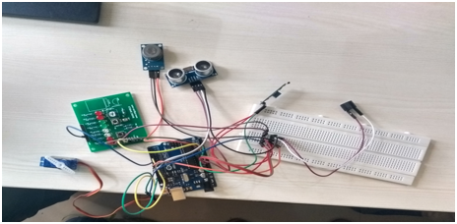
Circuit :

Slide 8
Advantages :
Data Sent by sensors are analysed, promoting Lighting adjustment .
Smoke sensor provide alarm you to get out from House.
Fire sensor provide a notification to your mobile,when fire accident takes place.
Ultrasonic sense the object and it will open the gate by using servo motor

Slide 9


